Slide 1






P R E S E N T A T I O N
2 0 2 6
Student Name
Bora Usha
Student Email
borausha32@gmail.com
Mentor Name
MS. Uma Maheswari

Slide 2
Unlocking Sales Insights for Revenue Growth

Slide 3

Outline
Abstract of the Project
Problem Statement
Proposed Solution
System Architecture
Live Demo of the Project
Embedded Video of Project
Conclusion
Future Scope

Slide 4



Abstract
This project aims to analyze sales data to uncover meaningful insights that can help improve business performance and revenue growth. Organizations often collect large amounts of data but fail to use it effectively. In this project, raw sales data is cleaned, processed, and analyzed using Microsoft Excel.
Various techniques such as pivot tables, charts, and dashboards are used to visualize trends and patterns. The project focuses on identifying top-performing products, regional sales distribution, and monthly trends. The final output is an interactive dashboard that helps in better decision-making and strategic planning.

Slide 5



Problem Statement
Organizations today generate a significant amount of sales data; however, much of this data remains underutilized due to the lack of proper analysis techniques. As a result, important patterns and trends often go unnoticed, leading to inefficient business strategies and missed opportunities for revenue growth.
There is a strong need for a structured, data-driven approach that can transform raw sales data into meaningful insights. By effectively analyzing this data, businesses can improve decision- making, identify performance gaps, and enhance overall operational efficiency.

Slide 6

Proposed Solution
To address the problem of underutilized sales data, this project adopts a data-driven approach using Microsoft Excel. The solution begins with collecting and cleaning the raw dataset to ensure that the data is accurate, consistent, and ready for analysis.
After preprocessing, pivot tables are used to analyze important aspects such as sales by category, region, and time. Charts and graphs are then created to visually represent trends and patterns, making the data easier to understand.
Finally, an interactive dashboard is developed that combines key performance indicators (KPIs), charts, and slicers. This dashboard allows users to filter and explore the data dynamically, helping in identifying insights and supporting better business decision- making.

Slide 7
System Architecture
Data Input / Source
Processing / Analysis
The project uses a secondary sales dataset containing detailed information such as order date, product name, category, region, customer details, and sales amount. This data serves as the foundation for analysis and helps in understanding business performance across different dimensions.
The raw data is first cleaned by handling missing values, removing duplicates, and formatting fields such as dates. Additional columns like Month and Year are created to support time-based analysis. Pivot tables are then used to analyze sales by category, region, and time, helping to identify patterns and trends.
AI / Tool Integration
Output / Dashboard
Microsoft Excel is used as the primary tool for data processing and visualization. Features such as pivot tables, charts, and slicers are utilized to perform analysis and create an interactive dashboard. These tools help in transforming raw data into meaningful insights efficiently.
The final output is an interactive dashboard that displays key performance indicators (KPIs), charts, and filters. The dashboard allows users to explore data dynamically and gain insights into sales trends, product performance, and regional distribution, supporting better decision-making.

Slide 8
Live Demo of Project
Here's the list of some demo features of the project:
Demo 1
CATEGORY-WISE SALES ANALYSIS
This demo shows sales performance across different product categories using a bar chart. It helps compare category-wise revenue and identify the highest performing category. The result highlights which category contributes the most to total sales.
Demo 2
REGIONAL SALES ANALYSIS
This demo displays sales distribution across regions using a pie chart. It helps in comparing regional performance and identifying high and low-performing regions. The result shows which region generates the highest sales.
Demo 3
MONTHLY SALES TREND & SLICERS
This demo shows monthly sales trends using a line chart along with interactive slicers. Users can filter data by region, category, or segment, and charts update dynamically. The result helps in understanding sales patterns and improves decision- making.

Slide 9



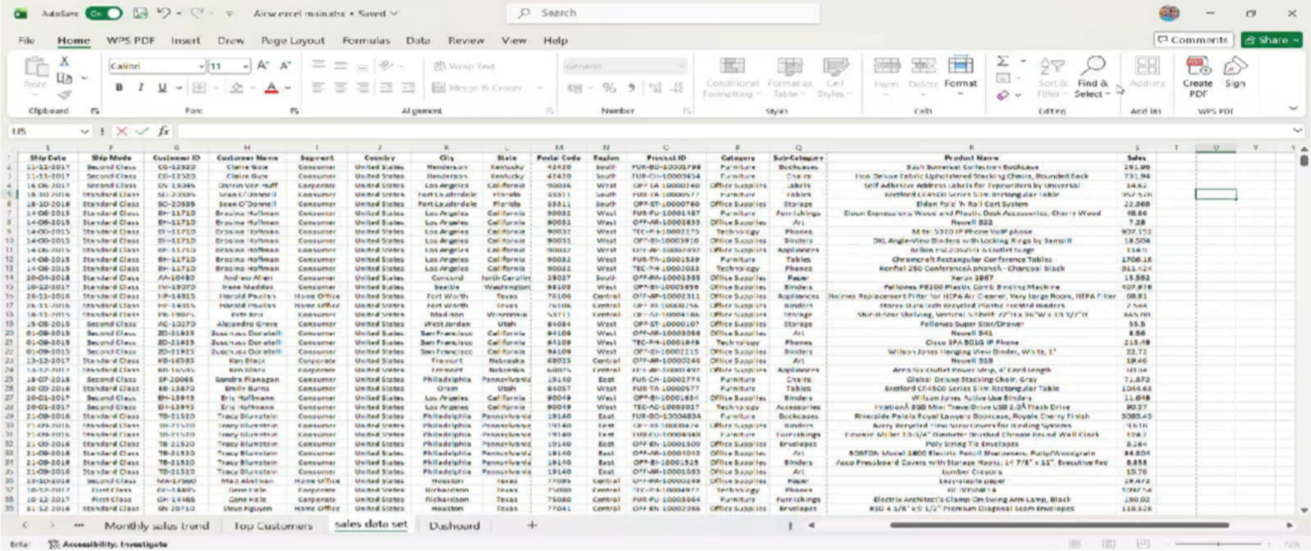
▶
Video of Project Demo
[Insert your project demo video.
You can embed a video your live project.]

Slide 10

Conclusion
This project successfully demonstrates how raw sales data can be transformed into meaningful insights using data analysis and visualization techniques in Microsoft Excel. By applying data cleaning, pivot tables, and charts, important trends and patterns were identified across categories, regions, and time.
The interactive dashboard provides a clear and user- friendly way to monitor key performance indicators and supports better decision-making. Overall, the project highlights the importance of a data-driven approach in improving business performance, increasing efficiency, and driving revenue growth.

Slide 11

Future Scope
This project can be further enhanced by using advanced features within Microsoft Excel, such as Power Query and advanced dashboard techniques, to handle larger datasets more efficiently.
In the future, the project can also be extended by integrating real-time data to provide up-to-date insights. Additionally, advanced tools like Power BI can be used to create more interactive and dynamic dashboards.
The project can also be improved by applying predictive analysis techniques to forecast future sales trends and support better decision-making.

Slide 12
Thank You
A I C W F e l l o w s h i p | S t u d e n t P r o j e c t P r e s e n t a t i o n 2 0 2 6
LinkedIn | Edunet Foundation

